Slide 1


Step-by-Step Exploratory Data Analysis (EDA) Using Python
Mastering Data Insights through Systematic Exploratory Analysis
https://www.kaggle.com/datasets/sukhmanibedi/cars4u/data

Slide 2


EDA Provides the Foundation for Reliable Predictive Modeling
Core Objectives
Exploratory Data Analysis (EDA) is a foundational method of analyzing datasets to understand their core characteristics. It involves summarizing data features and uncovering hidden relationships through visual and statistical techniques.
Objective
Description
Assess missing values, outliers, and errors.
Data Quality
Identify trends and distributions in variables.
By performing EDA, data scientists gain deep insights that allow them to check assumptions, spot anomalies, and formulate robust hypotheses for further advanced analysis.
Patterns
Understand how features interact with each other.
Relationships
Formulate ideas for modeling and engineering.
Hypothesis
"EDA is not just about plotting charts; it is a rigorous investigation of data integrity."

Slide 3




Essential Python Libraries Power the EDA Workflow
Pandas & NumPy
The workhorses for data manipulation, cleaning, and handling complex numerical arrays.
Matplotlib & Seaborn
Powerful libraries for creating both static, basic charts and advanced statistical visualizations.
Environment Setup
Workflow Tip
Always use warnings.filterwarnings('ignore') to keep your analysis output clean and focused on insights.

Slide 4


Inspection Toolkit
Initial Data Acquisition and Inspection Reveal Dataset Structure
Tool
Insight Provided
Reveals 7253 observations and 14 features.
Loading the data into a Pandas DataFrame is the starting point for analysis. The read_csv() function converts tabular data into a structured format ready for manipulation.
shape
Glimpse into actual data entries and formatting.
head()
Identifies data types and missing value columns.
info()
data = pd.read_csv("used_cars.csv")
Distinguishes continuous vs categorical variables.
nunique()
Initial inspection tools provide an immediate overview of the dataset's scale and composition, allowing us to "listen" to the data before making any inferences.
Data Understanding Phase

Slide 5
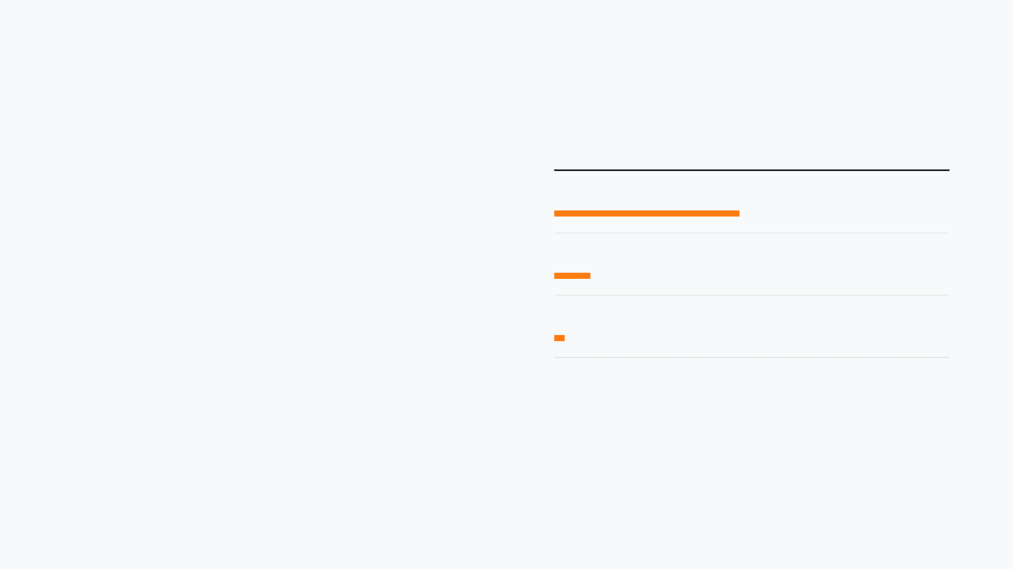


Data Integrity
Missing Value Analysis
Rigorous Data Quality Checks Identify Missing Values and Duplicates
Feature
Missing Percentage
~86%
New_Price
Understanding the "gaps" in your data is crucial before proceeding to analysis. Missing values can significantly skew results if not handled correctly.
~17%
Price
< 5%
Mileage / Engine / Power
Missing Value Impact: Identifying columns that need dropping or heavy imputation.
*High missing percentages in 'New_Price' suggest it may not be a reliable predictor without significant imputation.
Duplicate Detection: Ensuring observations aren't counted multiple times to avoid bias.

Slide 6

Strategic Feature Engineering Transforms Raw Data into Insights
Feature engineering is the process of using domain knowledge to create new, more predictive variables from raw data. This step is crucial for enhancing model performance and making data more intuitive.
Technique
Action & Insight
Temporal Features
Converting manufacturing years into
Car_Age
Data Transformation
Text Extraction
Splitting the Name column into
Brand
and
Model
Data Reduction
Dropping non-informative columns like
S.No
"The goal of feature engineering is to create meaningful data that captures the underlying patterns of the business problem."

Slide 7


Statistical Summaries Expose Outliers and Data Distribution
Statistical Flags
Detecting Outliers
Extreme values in Kilometers Driven and Price indicate potential outliers that could disproportionately influence model performance.
Feature
Observation
KM Driven
Max 650k KM (Outlier)
Spotting Entry Errors
Min 0 (Entry Error)
A minimum value of 0 for Mileage is a clear data entry issue, as functional vehicles cannot have zero fuel efficiency.
Mileage
Engine
Right-skewed data
Skewness Analysis
Price
Max 160k (Outlier)
Engine and Power variables show right-skewness, suggesting the need for normalization or log transformation in later steps.
Using data.describe().T to transpose the summary for better readability of numerical features.

Slide 8



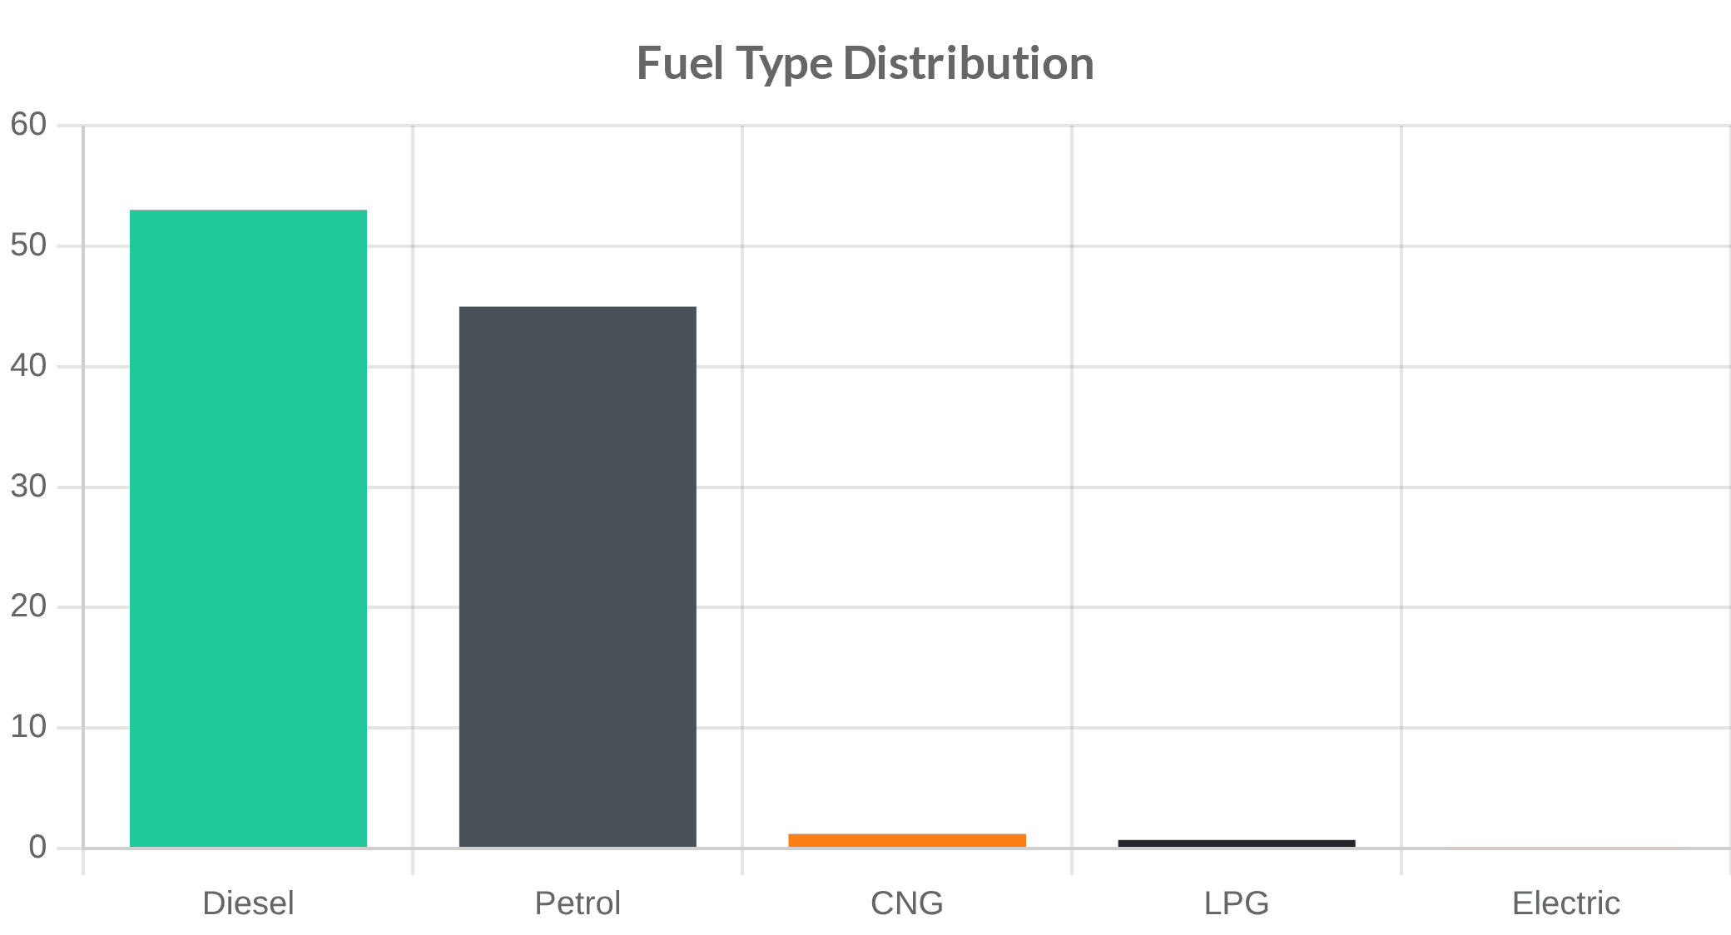
Univariate Analysis: Numerical Variables
Categorical Insights
Frequency Patterns
Distribution & Spread
→
Histograms:
Used to visualize the frequency distribution and identify skewness in variables like Price.
→
Box Plots:
Essential for spotting outliers and understanding the quartiles of the data.
→
Key Finding:
Price and Kilometers Driven are significantly right-skewed, requiring transformation.
Data Quality
Outliers in Kilometers Driven (up to 650k) and 0-mileage entries were identified as critical data entry issues.
→
Fuel Type:
~53% of cars are Diesel, indicating a preference for performance.
→
Transmission:
~72% of the dataset consists of Manual transmission cars.
→
Location:
Mumbai, Hyderabad, and Coimbatore are the top hubs for used cars.

Slide 9




Implementation
Data Transformation Normalizes Skewed Features for Better Scaling
Log Transformation
When variables like Price or Kilometers_Driven are highly skewed, they can negatively impact statistical models. Log transformation is a powerful technique to address this.
# Applying Log Transformation
def log_transform(data, col):
for colname in col:
data[colname + '_log'] = np.log(data[colname])
log_transform(data, ['Price', 'Kilometers_Driven'])
Normalization
Log transformation helps in normalization, ensuring variables maintain a standard scale with others.
Applying np.log helps in bringing skewed data closer to a normal distribution, making it more suitable for linear models.
Standardization
It ensures that variables with large scales do not disproportionately influence the analysis compared to smaller-scale variables.
Result: Improved data symmetry and model stability.

Slide 10

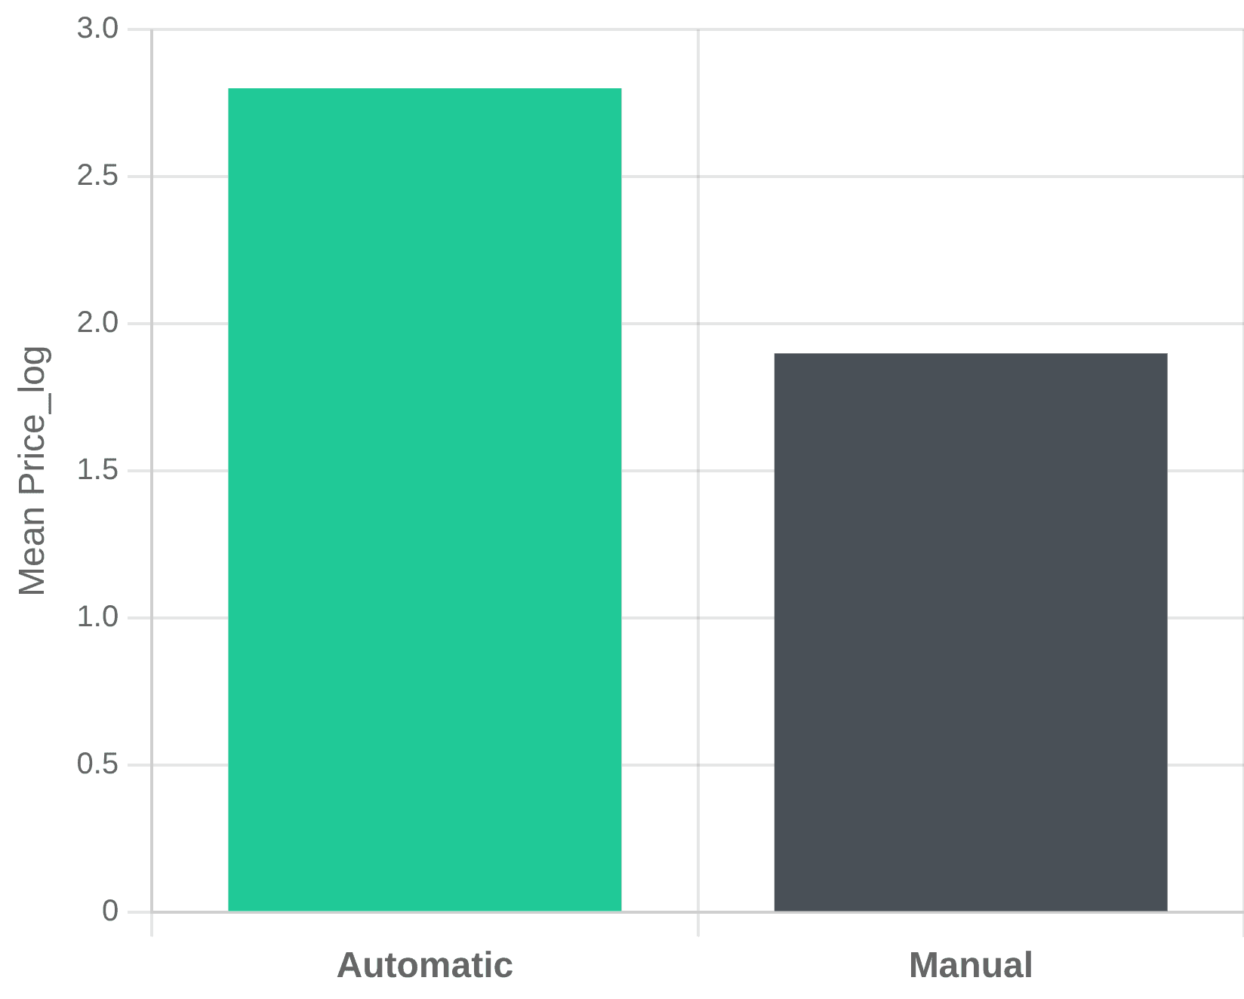




Categorical Impact
Bivariate Analysis Uncovers Critical Relationships Between Features
Transmission vs Price
Bivariate analysis explores how two variables interact, helping us identify which factors directly influence the target variable, the car price.
Performance Drivers: Engine size and Power show a strong positive correlation with Price. As performance increases, so does the value.
Depreciation: Car Age shows a strong negative correlation with Price. Recent models are significantly more expensive.
Fuel Efficiency: Mileage is negatively correlated with Power and Engine size, reflecting the performance-efficiency trade-off.
Ownership: First-owner cars command higher prices, followed by second-owner vehicles.
Automatic cars consistently command a higher average price compared to manual variants across all locations.

Slide 11




Correlation Matrix
Multivariate Heatmaps Reveal Complex Interdependencies
Price
Engine
Power
Mileage
Price
1.00
0.69
0.77
-0.31
Strongest Links
Engine
0.69
1.00
0.86
-0.71
Engine and Power show a very strong positive correlation (0.86), indicating they scale together in performance vehicles.
Power
0.77
0.86
1.00
-0.70
Performance Trade-offs
Mileage is negatively correlated with Engine and Power, reflecting the inherent trade-off between power and fuel efficiency.
Mileage
-0.31
-0.71
-0.70
1.00
Price Drivers
Positive
Negative
Neutral
Power (0.77) and Engine size (0.69) are the most significant positive drivers of used car prices in this dataset.

Slide 12


Systematic Data Imputation Ensures a Complete and Clean Dataset
Addressing missing values requires a blend of statistical techniques and domain knowledge to maintain the integrity of the dataset.
Final Conclusion
EDA is an essential, iterative process that ensures data quality and provides the deep insights necessary for robust predictive modeling.
Strategy
Application
Mean/Median
Used for variables like
Mileage
where the distribution is stable.
Domain-Based
Filling
Seats
or
Engine
values based on similar Brand/Model entries.
By uncovering patterns and addressing anomalies, we transform raw data into a reliable foundation for machine learning success.
Handling specific entry errors before applying statistical averages.
Zero-Fill
Ready for Modeling
Finalizing the imputation step ensures the data is normalized, standardized, and ready for advanced machine learning algorithms.
Analytics Vidhya Guide

